Slide 1
Induced Surface Charge
Xuan Ruan

Slide 2
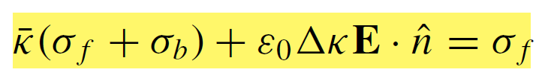
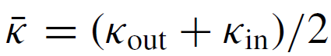
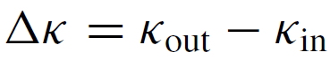
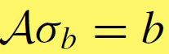
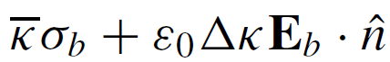
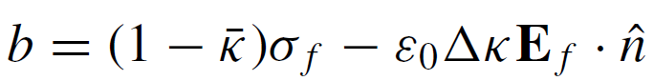
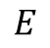
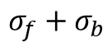
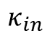
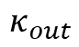
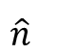
Equations
$$E$$
$$\hat{n}$$
Governing equation:
$$σ_{f}+σ_{b}$$
$$κ_{out}$$
$$κ_{in}$$
Dielectric constant:
Unknown
Known

Slide 3
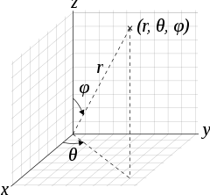
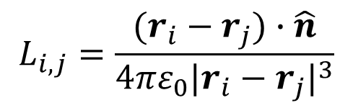
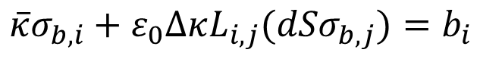
Equations
$$E$$
$$\hat{n}$$
$$σ_{f}+σ_{b}$$
$$κ_{out}$$
Unknown
Known
$$κ_{in}$$
$$\overline{κ}σ_{b,i}+ε_{0}ΔκL_{i,j}({dSσ}_{b,j})=b_{i}$$
$$L_{i,j}=\frac{(r_{i}−r_{j})∙\hat{n}}{4πε_{0}{|r_{i}−r_{j}|}^{3}}$$

Slide 4
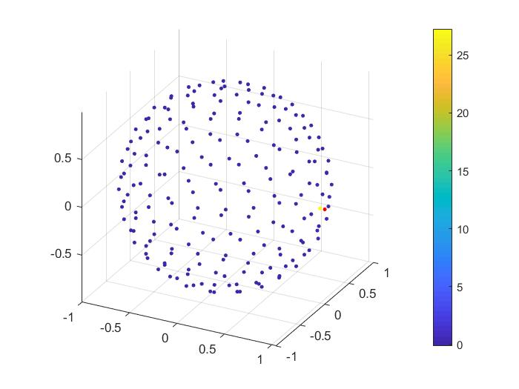
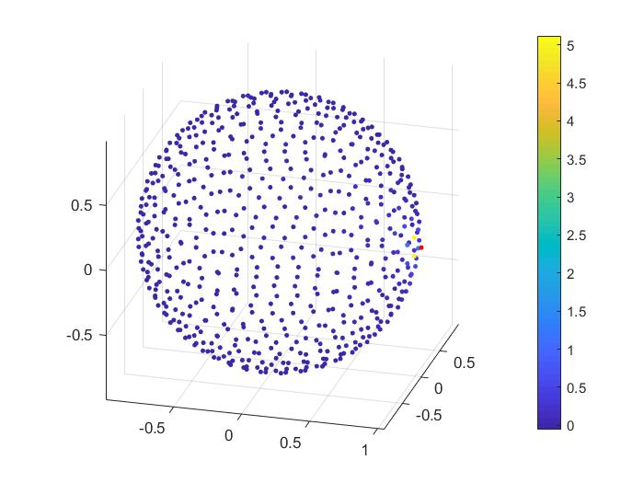
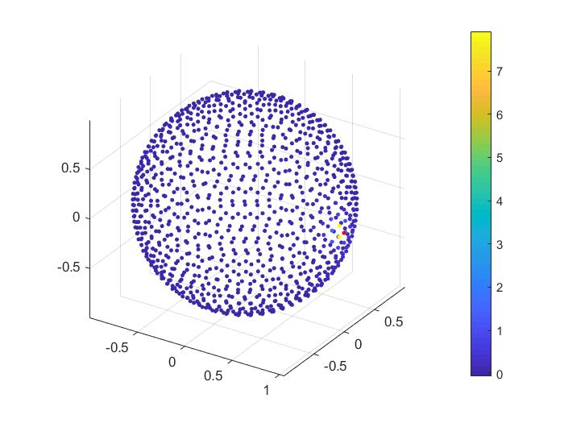
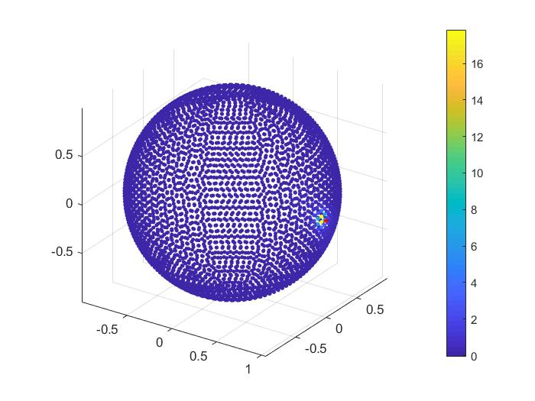
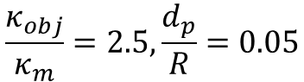
Number of patches
$$\frac{κ_{obj}}{κ_{m}}=2.5,\frac{d_{p}}{R}=0.05$$
N=200
N=600
N=1024
N=4000

Slide 5
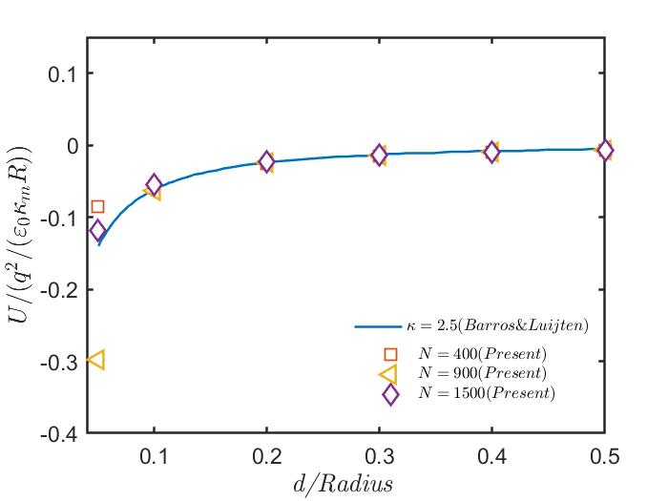
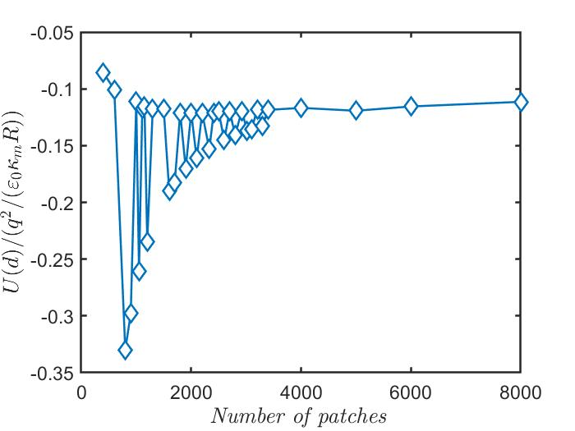
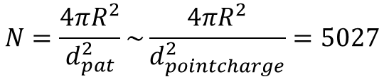
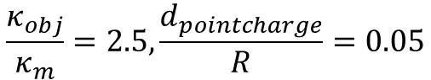
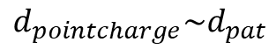
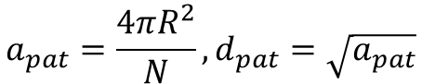
Number of patches
$$\frac{κ_{obj}}{κ_{m}}=2.5,\frac{d_{pointcharge}}{R}=0.05$$
N: number of patches
$$a_{pat}=\frac{4πR^{2}}{N},d_{pat}=\sqrt{a_{pat}}$$
$$N=\frac{4πR^{2}}{d_{pat}^{2}}\sim \frac{4πR^{2}}{d_{pointcharge}^{2}}=5027$$
$$d_{pointcharge}\sim d_{pat}$$

Slide 6
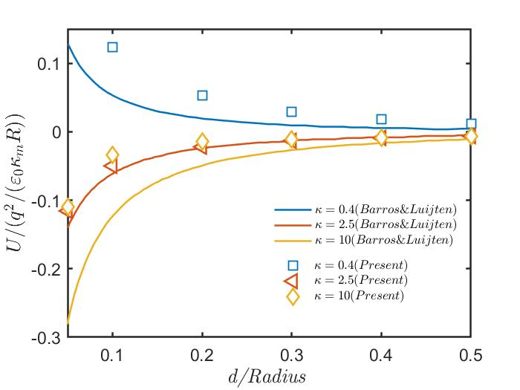

Different dielectric constants
$$N=6000$$

Slide 7
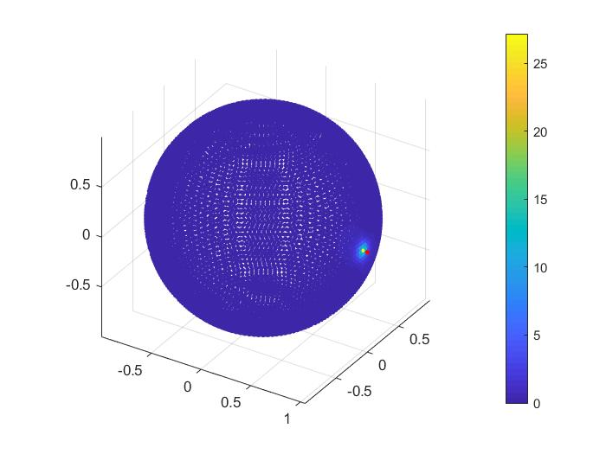

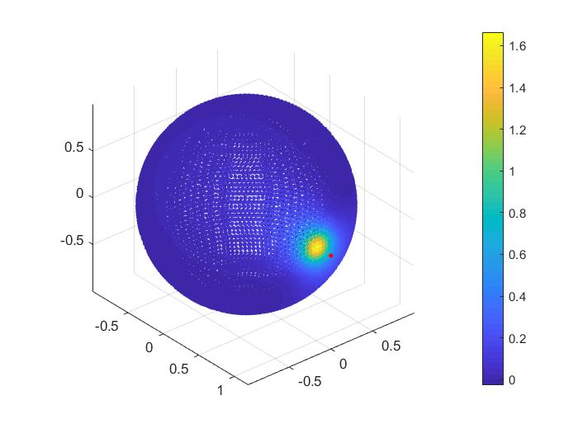
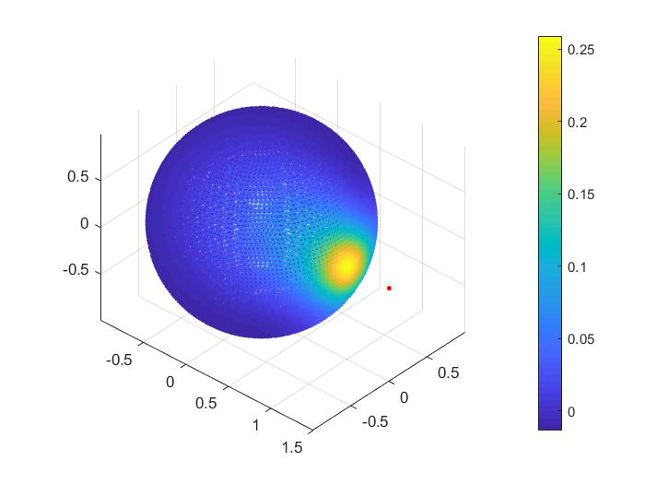
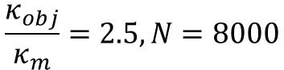
Different distances
$$\frac{κ_{obj}}{κ_{m}}=2.5,N=8000$$
d=0.05R
d=0.1R
d=0.2R
d=0.5R

Slide 8
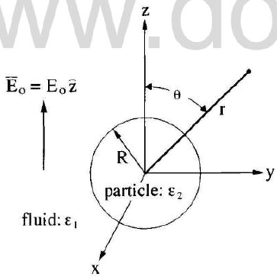
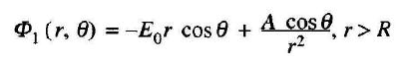
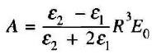
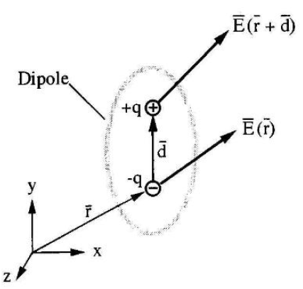
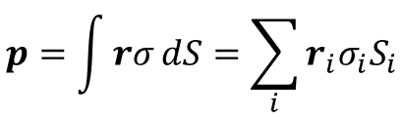
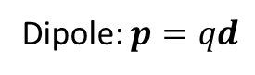
Dielectric ball in an external field
Thomas Jones, Electromechanics of Particles, 1995.
Theoretical solution:
Coefficient A:
Dipole: $p=qd$
$$p=\int{rσ}dS=\sum_{i}{r_{i}σ_{i}S_{i}}$$
Integral form
Discrete form

Slide 9
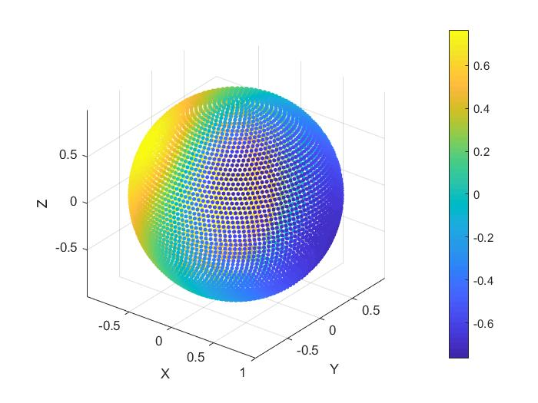
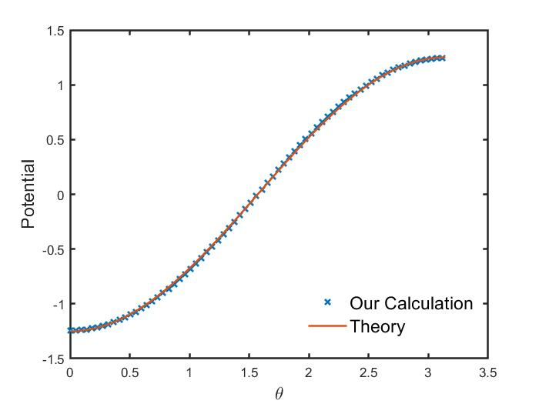
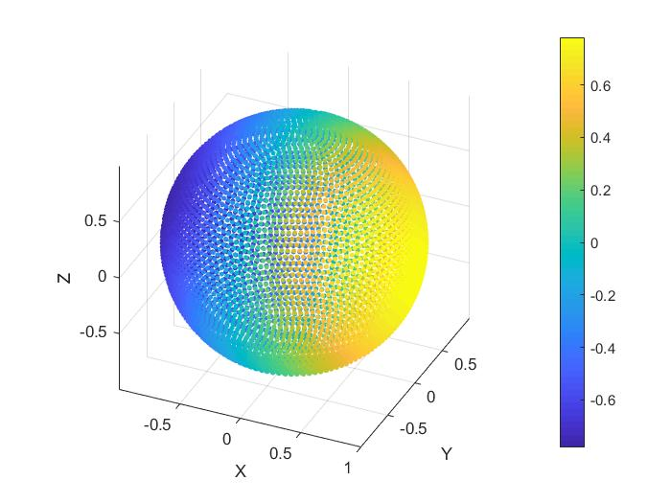
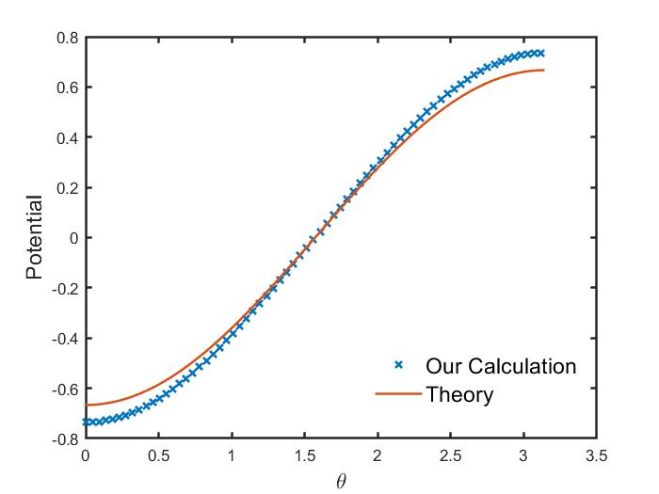
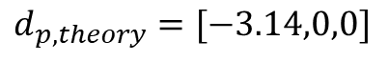
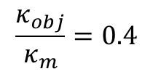
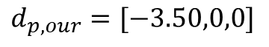
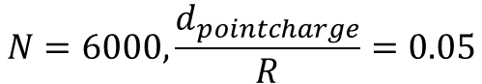
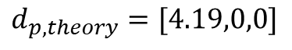
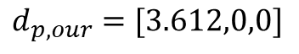
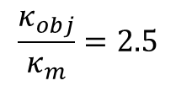
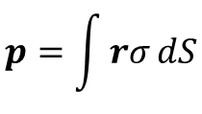
Dielectric ball in an electric field
$$N=6000,\frac{d_{pointcharge}}{R}=0.05$$
$$p=\int{rσ}dS$$
$$\frac{κ_{obj}}{κ_{m}}=0.4$$
$$d_{p,our}=[−3.50,0,0]$$
$$d_{p,theory}=[−3.14,0,0]$$
$$\frac{κ_{obj}}{κ_{m}}=2.5$$
$$d_{p,our}=[3.612,0,0]$$
$$d_{p,theory}=[4.19,0,0]$$

Slide 10
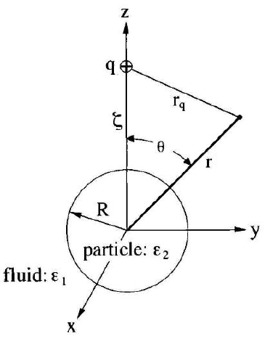
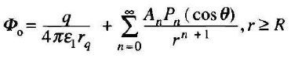


Dielectric ball in field of point charge
Thomas Jones, Electromechanics of Particles, 1995.
Theoretical solution:
Coefficient An:
Legendre polynomial Pn:

Slide 11






Dielectric ball in field of point charge
Wrong
$$N=6000,\frac{d_{pointcharge}}{R}=0.05$$
$$\frac{κ_{obj}}{κ_{m}}=0.4$$
$$\frac{κ_{obj}}{κ_{m}}=2.5$$

Slide 12




Bug
From here
Correct
$$N=8000$$

Slide 13



Dielectric ball in field of point charge
Correct
Barros & Luijten, PRL, 2014
$$U_{0}=\frac{q^{2}}{πε_{0}κ_{m}R}$$

Slide 14



Dielectric ball in field of point charge
Correct
Jones, 1995
$$\frac{κ_{obj}}{κ_{m}}=2.5, N=2000$$
$$ψ_{0}=\frac{|q|}{4πε_{0}R}$$

Slide 15





Ellipsoids
Wrong
(1) Non-uniform patches (Patch area?)
(2) Definition of normal vectors
$${(x/a)}^{2}+{(y/b)}^{2}+{(z/c)}^{2}=r$$
$$f\left(x,y,z,r\right)={(x/a)}^{2}+{(y/b)}^{2}+{(z/c)}^{2}−r=0$$
$$n=∇f/|∇f|$$
$$f_{1}\left(x,y,z,r\right)={(x/a)}^{2}+{(y/b)}^{2}+{(z/c)}^{2}−r=0$$
$$f_{2}\left(x,y,z,Cr\right)={(x/a)}^{2}+{(y/b)}^{2}+{(z/c)}^{2}−Cr=0$$
$$n_{i}=(x_{i,Cr}−x_{i,r})/|x_{i,Cr}−x_{i,r}|$$
N=210

Slide 16


Ellipsoids
Wrong

Slide 17

Ellipsoids
Wrong

Slide 18







Nearly Uniform Patches
Correct
$$f=\frac{x^{2}}{a^{2}}+\frac{y^{2}}{b^{2}}+\frac{z^{2}}{c^{2}}−1=0$$
Coordinates of N patches:
$$z_{n}=c∙(\frac{2n−1}{N}−1)$$
$$x_{n}=a\sqrt{\frac{2n−1}{N}(2−\frac{2n−1}{N})}cos⁡(2πnφ)$$
$$y_{n}=b\sqrt{\frac{2n−1}{N}(2−\frac{2n−1}{N})}sin⁡(2πnφ)$$
$$φ=(\sqrt{5}−1)/2$$
$$n=1,2,…,N$$

Slide 19


Normal Vector
Correct
$$f=\frac{x^{2}}{a^{2}}+\frac{y^{2}}{b^{2}}+\frac{z^{2}}{c^{2}}−1=0$$
$$n=\frac{∇f}{\left|∇f\right|}=\frac{(\frac{x}{a^{2}},\frac{y}{b^{2}},\frac{z}{c^{2}})}{\sqrt{\frac{x^{2}}{a^{4}}+\frac{y^{2}}{b^{4}}+\frac{z^{2}}{c^{4}}}}$$

Slide 20

Results
Aspect ratio = 4

